Slide 1

User Requirement Analysis
Classroom Management System
Tasnim Ferdous 180041108
Sidratul Muntaha 180041118
Farhan Ishmam 180041120

Slide 2


Data Collection Methods
Target Users:
Staff
Teachers
Class Representatives
Students
Questionnaire
Interview
Google Forms were used for reaching many users in a short amount of time
Phone calls and texts were exchanged for more detailed personalized info
01
02
02

Slide 3
Major Findings
Problems Faced When Finding Classrooms
Willingness To Use An App
Responses by Students: 47
Responses by Class Representatives: 7
03

Slide 4
Sample Questions
Did you face any difficulty finding the scheduled classrooms?
Did you wait for another class to end before being able to access the classroom?
Did the faculty members cancel/reschedule classes due to not being able to find classrooms with proper equipment?
Would you like to use an app where you could view your scheduled/extra classes and quizzes with exact room numbers?
PYRAMID
Did you face any difficulty booking classrooms for unscheduled classes?
If the answer to the previous question was yes, can you explain the problems you faced?
Did you face problems informing the students and teachers about classrooms for unscheduled classes?
If there's any way you would like the current system to be changed then what would it be?
Is there any other feature you would like to add to the app or website that might help you in booking classrooms?
04

Slide 5
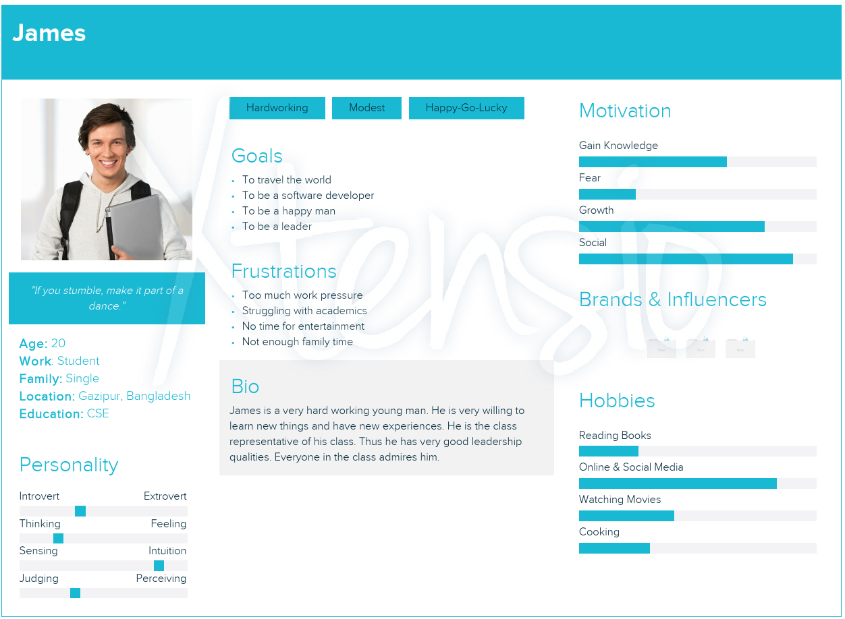
PERSONAS
JANUARY
05

Slide 6
Scenarios
James started his life at IUT with a bang, making new friends, going to new places and overall enjoying himself. Due to his outgoing and easy nature, he was selected as the Class Representative, but that was the start of all of his woes.
James could handle most of the work he had to do on behalf of his classmates, but one problem always seemed to haunt him: the issue of managing classrooms for lectures. Faculty members kept assigning extra classes and quizzes, even though no classrooms could be found to take them, and moreover, the classrooms assigned for regular classes were sometimes even occupied by senior students or faculty members, leading to the problem becoming even worse.
Scenario 1
James
06

Slide 7
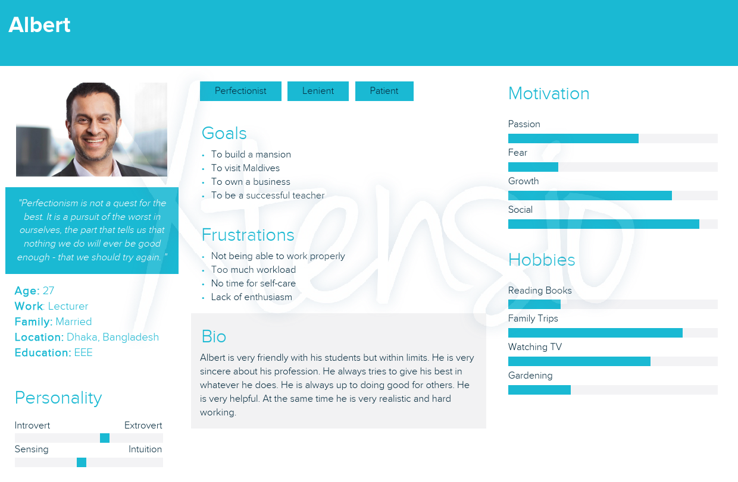
PERSONAS
JANUARY
07

Slide 8
Scenarios
Upon graduating from IUT, Albert immediately got a job offer as a faculty member, which he accepted as it was an easy way to earn money while he looked for other means. Being a perfectionist, Albert wanted his students to understand his lectures as much as possible in class, for which he tried to utilize as many whiteboards as possible.
However, as the years went by, the number of students in IUT started increasing until it exceeded capacity, and hence it became very difficult for him to find classes with an appropriate amount of whiteboards during his lectures. He thus had to reschedule or even cancel a lot of his lectures, all for the sake of trying to give his students a better environment for learning.
Scenario 2
Albert
08

Slide 9
Mandatory Requirements
Booking
Booking any classroom without conflicts and scheduled booking
Searching
Finding a classroom based on requirements
Updating
Requirements Based on data collected from targeted users
Access and modify previously booked records
Controlling
Access control for multiple categories of user
Access
Web-based access from anywhere.
09

Slide 10
Requirements
Want List
Wish List
Show class schedule and allocated rooms for general students
Access using an app along with class notifications
Integrate with other systems of IUT like grading system, internet management
Integrate class attendance system
10

Slide 11
THANK YOU

